Slide 1
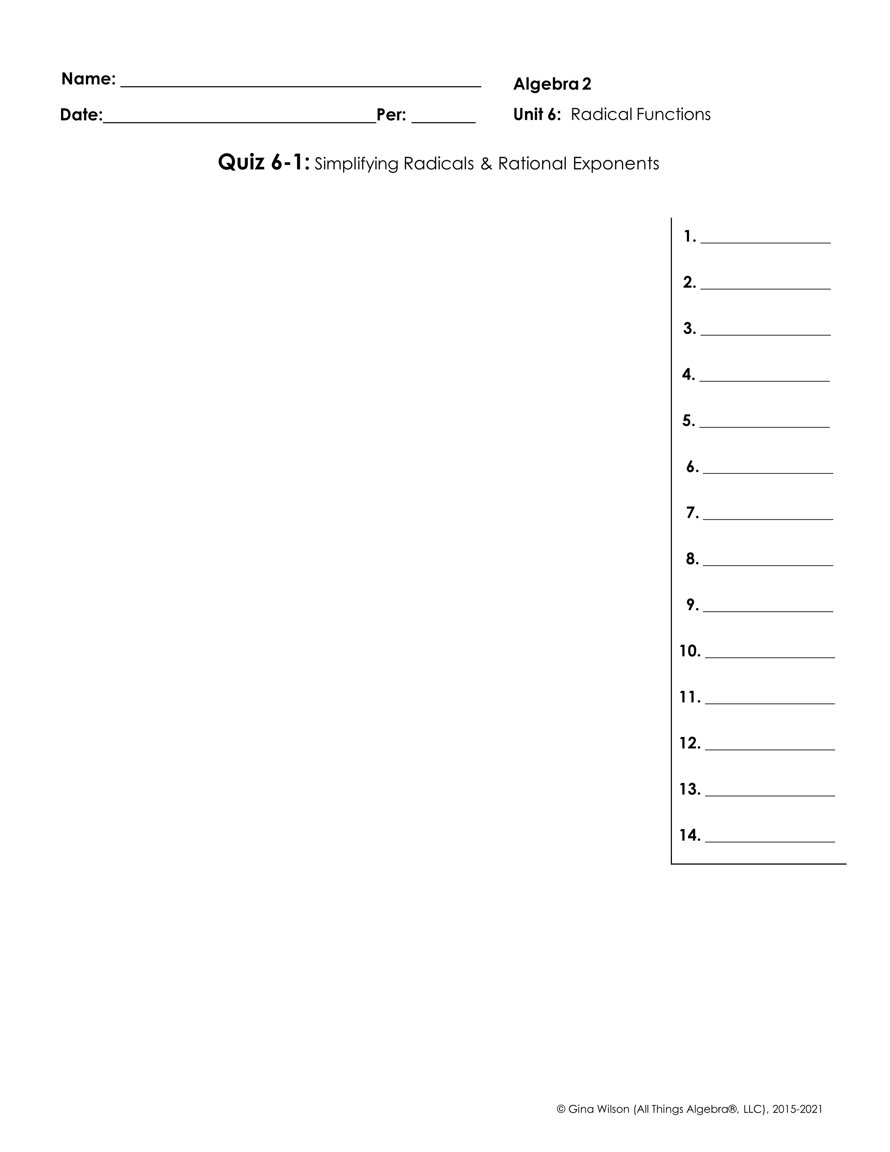
Write each expression in simplest radical form.
1.
2.
3.
4.
5.
6.
Write each expression in exponential form.
7.
8.
Simplify. Write each expression in simplest radical form.
9.
10.
11.
12.
13.
14.

